Slide 1
Programming C
Preprocessors, Macros, Header Files
Date: 20/12/2023

Slide 2
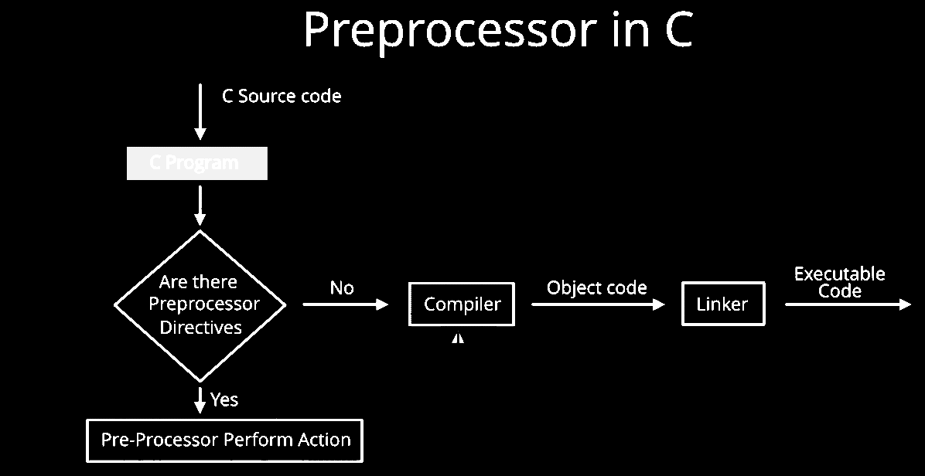
Preprocessor
Preprocessors are programs that process the source code before compilation.

Slide 3
Preprocessor Directives
Preprocessor programs provide preprocessor directives that tell the compiler to preprocess the source code before compiling.
All of these preprocessor directives begin with a ‘#’ (hash) symbol.
The ‘#’ symbol indicates that whatever statement starts with a ‘#’ will go to the preprocessor program to get executed.
We can place these preprocessor directives anywhere in our program (Preferably on top of the program).
Examples : #include, #define, #ifndef, etc.

Slide 4
#include - Directive
#include will include the code or content of the specified file in your program.
# symbol only provides a path to the preprocessor, and a command such as include is processed by the preprocessor program.
<> indicates system directory where “” indicates current directory.
#include<stdio.h> //there are no semicolon required here
#include “myheader” // <> indicates system directory where these libs are available, “” – indicates current directory where source codes resides

Slide 5
Types of Preprocessors
Macros
File Inclusion
Conditional compilation
Others directives
Macros
Macros are pieces of code in a program that is given some name.
Whenever this name is encountered by the compiler, the compiler replaces the name with the actual piece of code
The ‘#define’ directive is used to define a macro.
Syntax: #define token value
Example: #define LIMIT 5

Slide 6
Types of Preprocessors
Macros
File Inclusion
Conditional compilation
Others directives
Macros
#include <stdio.h>
#define LIMIT 5
int main()
{
for (int i = 0; i < LIMIT; i++) {
printf("%d \n", i);
}
return 0;
}

Slide 7
Types of Preprocessors
Macros
File Inclusion
Conditional compilation
Others directives
Macros with Arguments
Its also possible to pass arguments to macros.
Macros defined with arguments work similarly to functions.
#define sum (a, b) a + b
#define AREA (l,b) l * b
area = AREA(10, 12);
whenever the compiler finds AREA(l, b) in the program, it replaces it with the statement (l*b).

Slide 8
Types of Preprocessors
Macros
File Inclusion
Conditional compilation
Others directives
Macros with Arguments
#include <stdio.h>
#define min(a, b) (((a) < (b)) ? (a) : (b))
int main()
{
int a = 18;
int b = 76;
printf("Minimum value between"
" %d and %d is %d\n",
a, b, min(a, b));
return 0;
}

Slide 9
Types of Preprocessors
Macros
File Inclusion
Conditional compilation
Others directives
File Inclusion
Tells the compiler to include a file in the source code program.
The #include preprocessor directive is used to include the header files
2 types of files that can be included by the user in the program
Standard Header Files (Using <>)
User-defined Header Files (Using “”)

Slide 10
Types of Preprocessors
Macros
File Inclusion
Conditional compilation
Others directives
Conditional Compilation
Directive that helps to compile a specific portion of the program or to skip the compilation of some specific part of the program based on some conditions.
#if
#ifdef
#ifndef
#else
#elif
#endif - used to close off the #if, #ifdef, and #ifndef opening directives which means the preprocessing of these directives is completed.

Slide 11
Types of Preprocessors
Macros
File Inclusion
Conditional compilation
Others directives
Conditional Compilation
#define gfg 7
#if gfg > 200
#undef gfg
#define gfg 200
#elif gfg < 50
#undef gfg
#define gfg 50
#else
#undef gfg
#define gfg 100
#endif

Slide 12
Types of Preprocessors
Macros
File Inclusion
Conditional compilation
Others directives
Other Directive
#undef Directive - The #undef directive is used to undefine an existing macro.
#undef LIMIT
will undefine the existing macro LIMIT. After this statement, every “#ifdef LIMIT” statement will evaluate as false.

Slide 13
Predefined Macros
#include <stdio.h>
#define LIMIT 18
int main()
{
printf("%d", LIMIT);
#undef LIMIT
printf("%d", LIMIT); //this will leads to error.
return 0;
}

Slide 14
Predefined Macros
#include <stdio.h>
int main()
{
printf("Current File :%s\n", __FILE__);
printf("Current Date :%s\n", __DATE__);
printf("Current Time :%s\n", __TIME__);
printf("Line Number :%d\n", __LINE__);
return 0;
}

Slide 15
Types of Preprocessors
Macros
File Inclusion
Conditional compilation
Others directives
Other Directives
#pragma Directive - This directive is a special purpose directive and is used to turn on or off some features.
These types of directives are compiler-specific
#pragma startup: These directives help us to specify the functions that are needed to run before program startup (before the control passes to main()).
#pragma exit: These directives help us to specify the functions that are needed to run just before the program exit (just before the control returns from main()).

Slide 16
Creating header files
Instead of writing large and complex code, we can create our own header files and include them in our program to use whenever we want.
It enhances code functionality and readability.
First, create C program and save that file with “mymath.h” ext.
int add(int a, int b)
{
return (a + b);
}

Slide 17
Creating header files
Second, create another C program and include that header file , and call that function from that header file
#include "mymath.h"
int main()
{
int a = 13, b = 22;
printf("Sum is: %d", add(a, b));
}

Slide 18
Points to remember – header file
Function and type declarations, global variables, structure declarations can be in one file.
Do not use redundant or other header files, only minimal set of statements.
Don’t put function definitions in a header.
Put only what is necessary and keep the header file concise.

Slide 19
Exercises
Create header file with diff arithmetic functions such as add(int,int), subtract(int,int), multiply(int,int), divide(int,int) functions. Include this header file in another C program where you prompt user to enter 2 numbers and print the results of arithmetic functions.

Slide 20
References
https://www.javatpoint.com/c-programming-language-tutorial
https://www.tutorialspoint.com/cprogramming/index.htm
https://www.programiz.com/c-programming

Slide 21

What Questions do you have

Slide 22
Thank you
Thank you

